Slide 1


Lab Meeting 19.09.18
Notes:
A fascinating outcome of the developmental process is the diversification of a large number of cell types, all of which originate from one cell and share the same genome. But we still don’t completely understand how this cell type diversification is orchestrated,

Slide 2
Notes:
C elegans. And it is extremely powerful model actually, because it has relatively small amount of cells 558 after hatching in adult organism and what is much more important the development of the worm is invariant, and as you can see on this slide all this complexity of cell types is formed in 9-11 divisions and trajectories of all cells are well known.

Slide 10
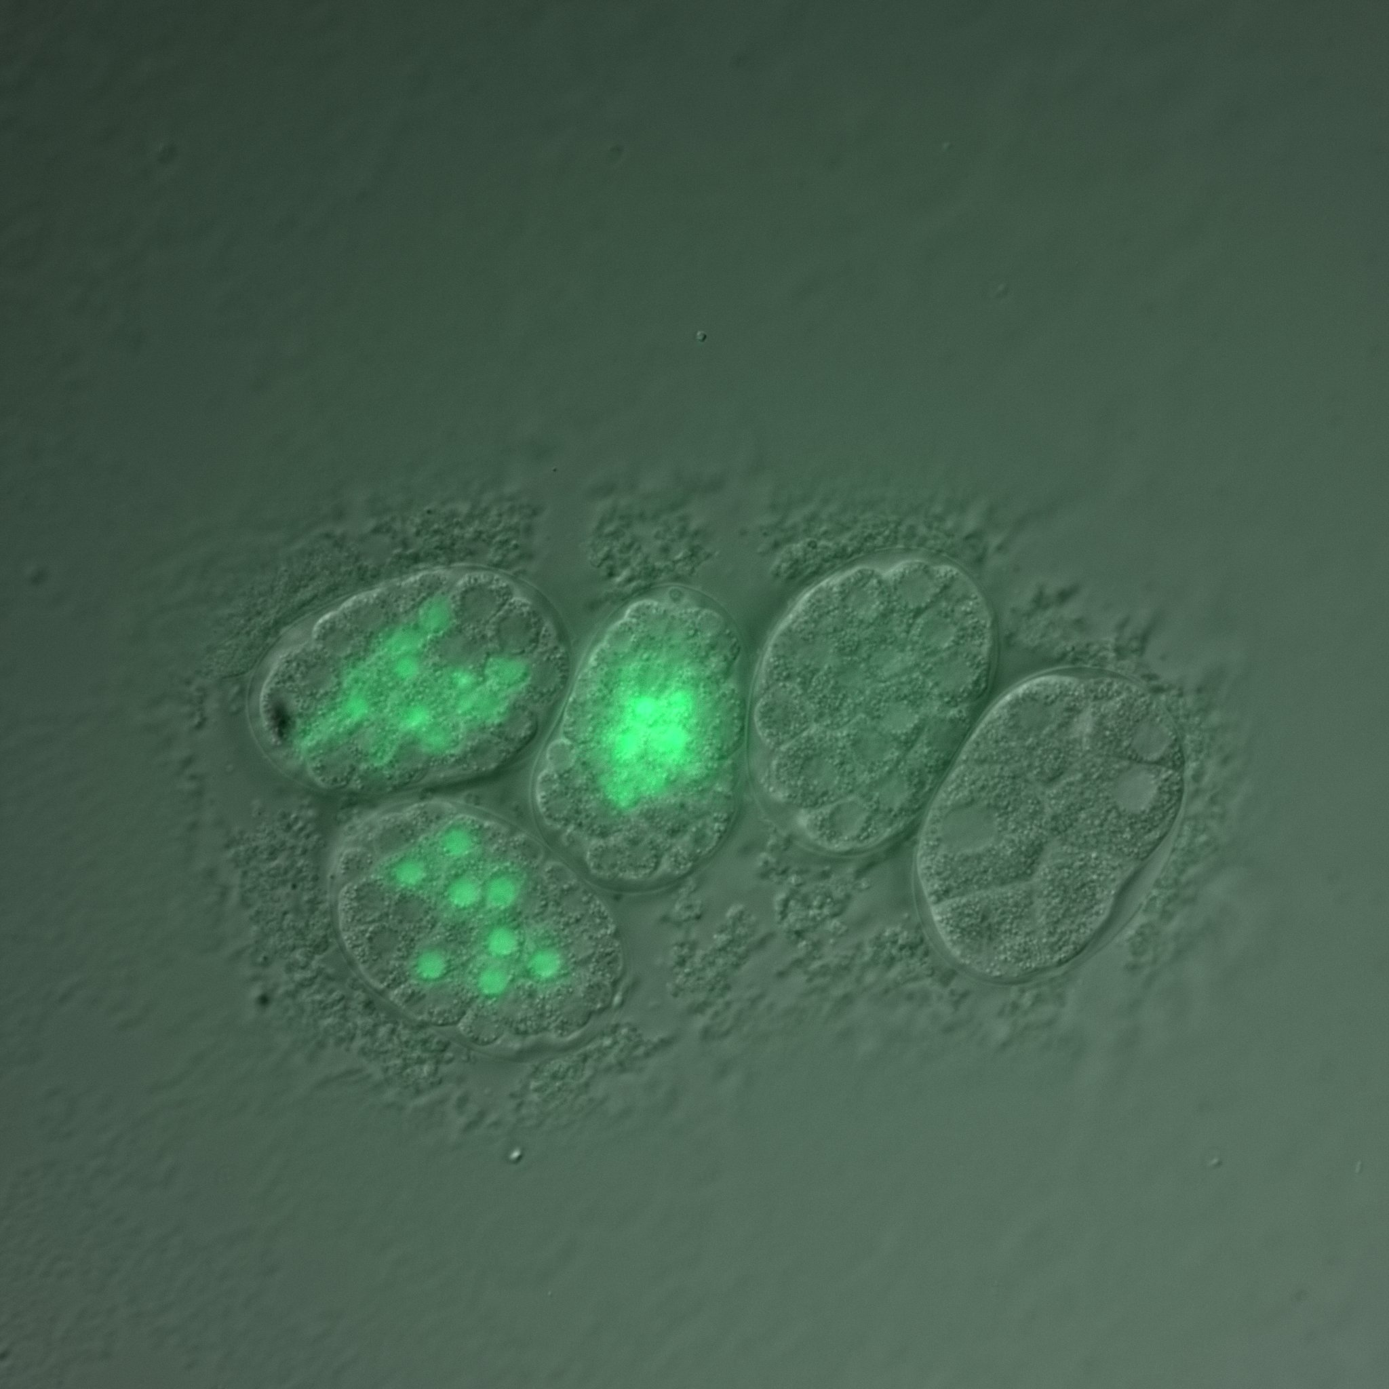
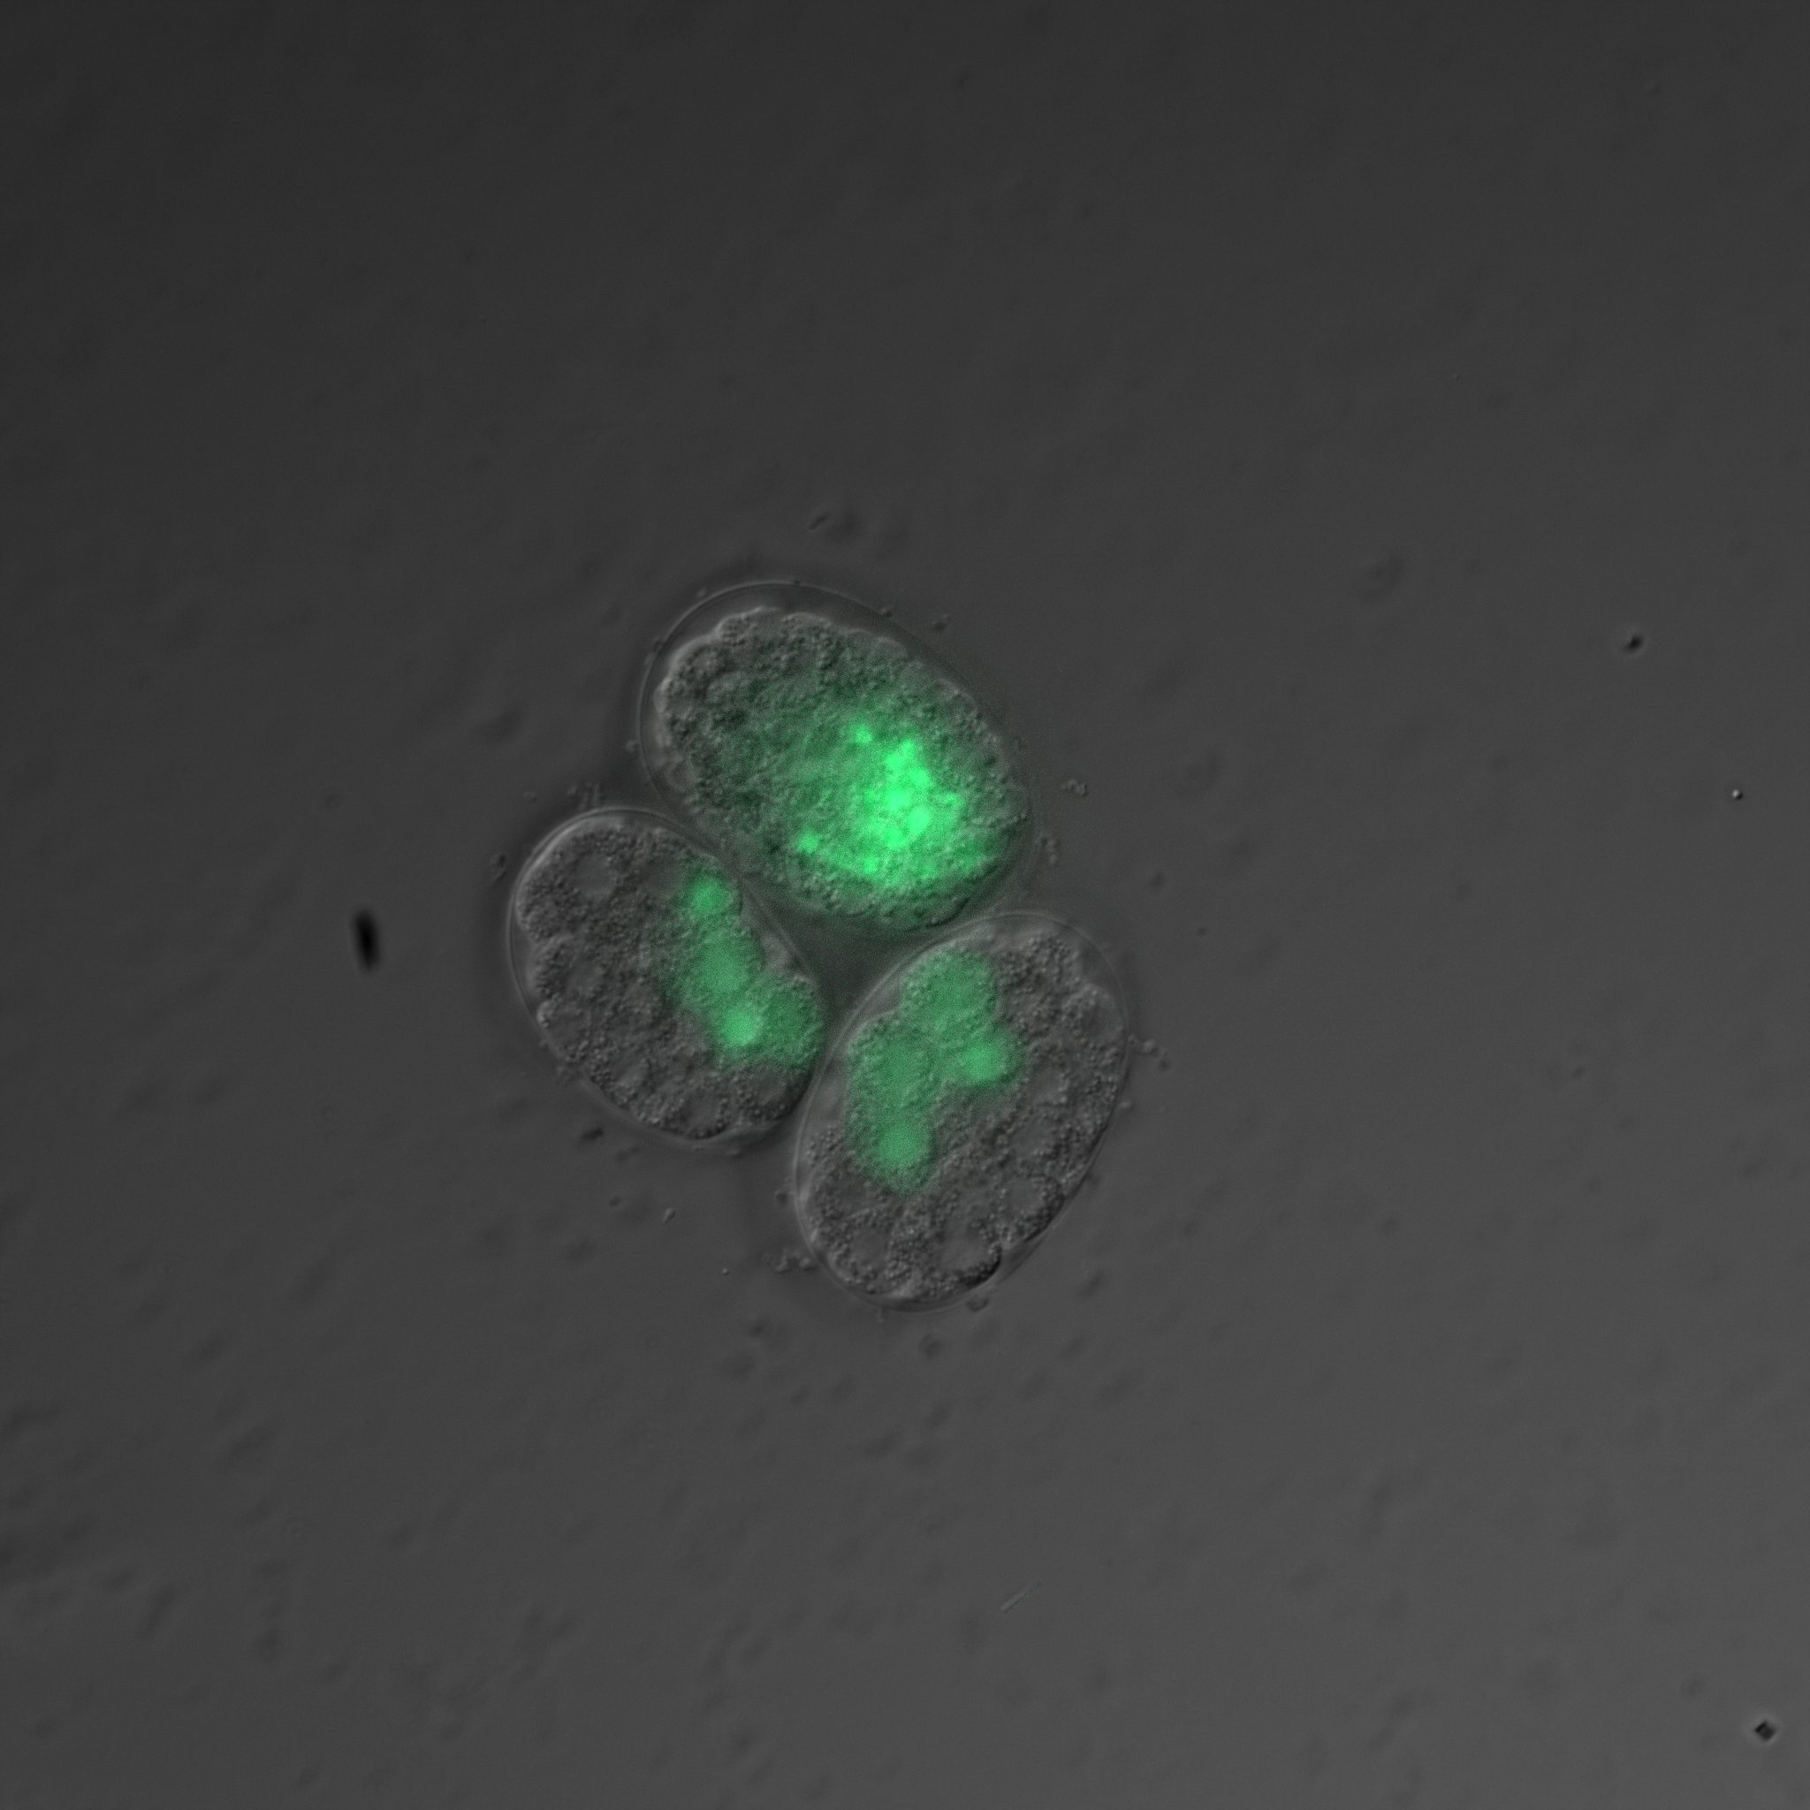

Slide 11
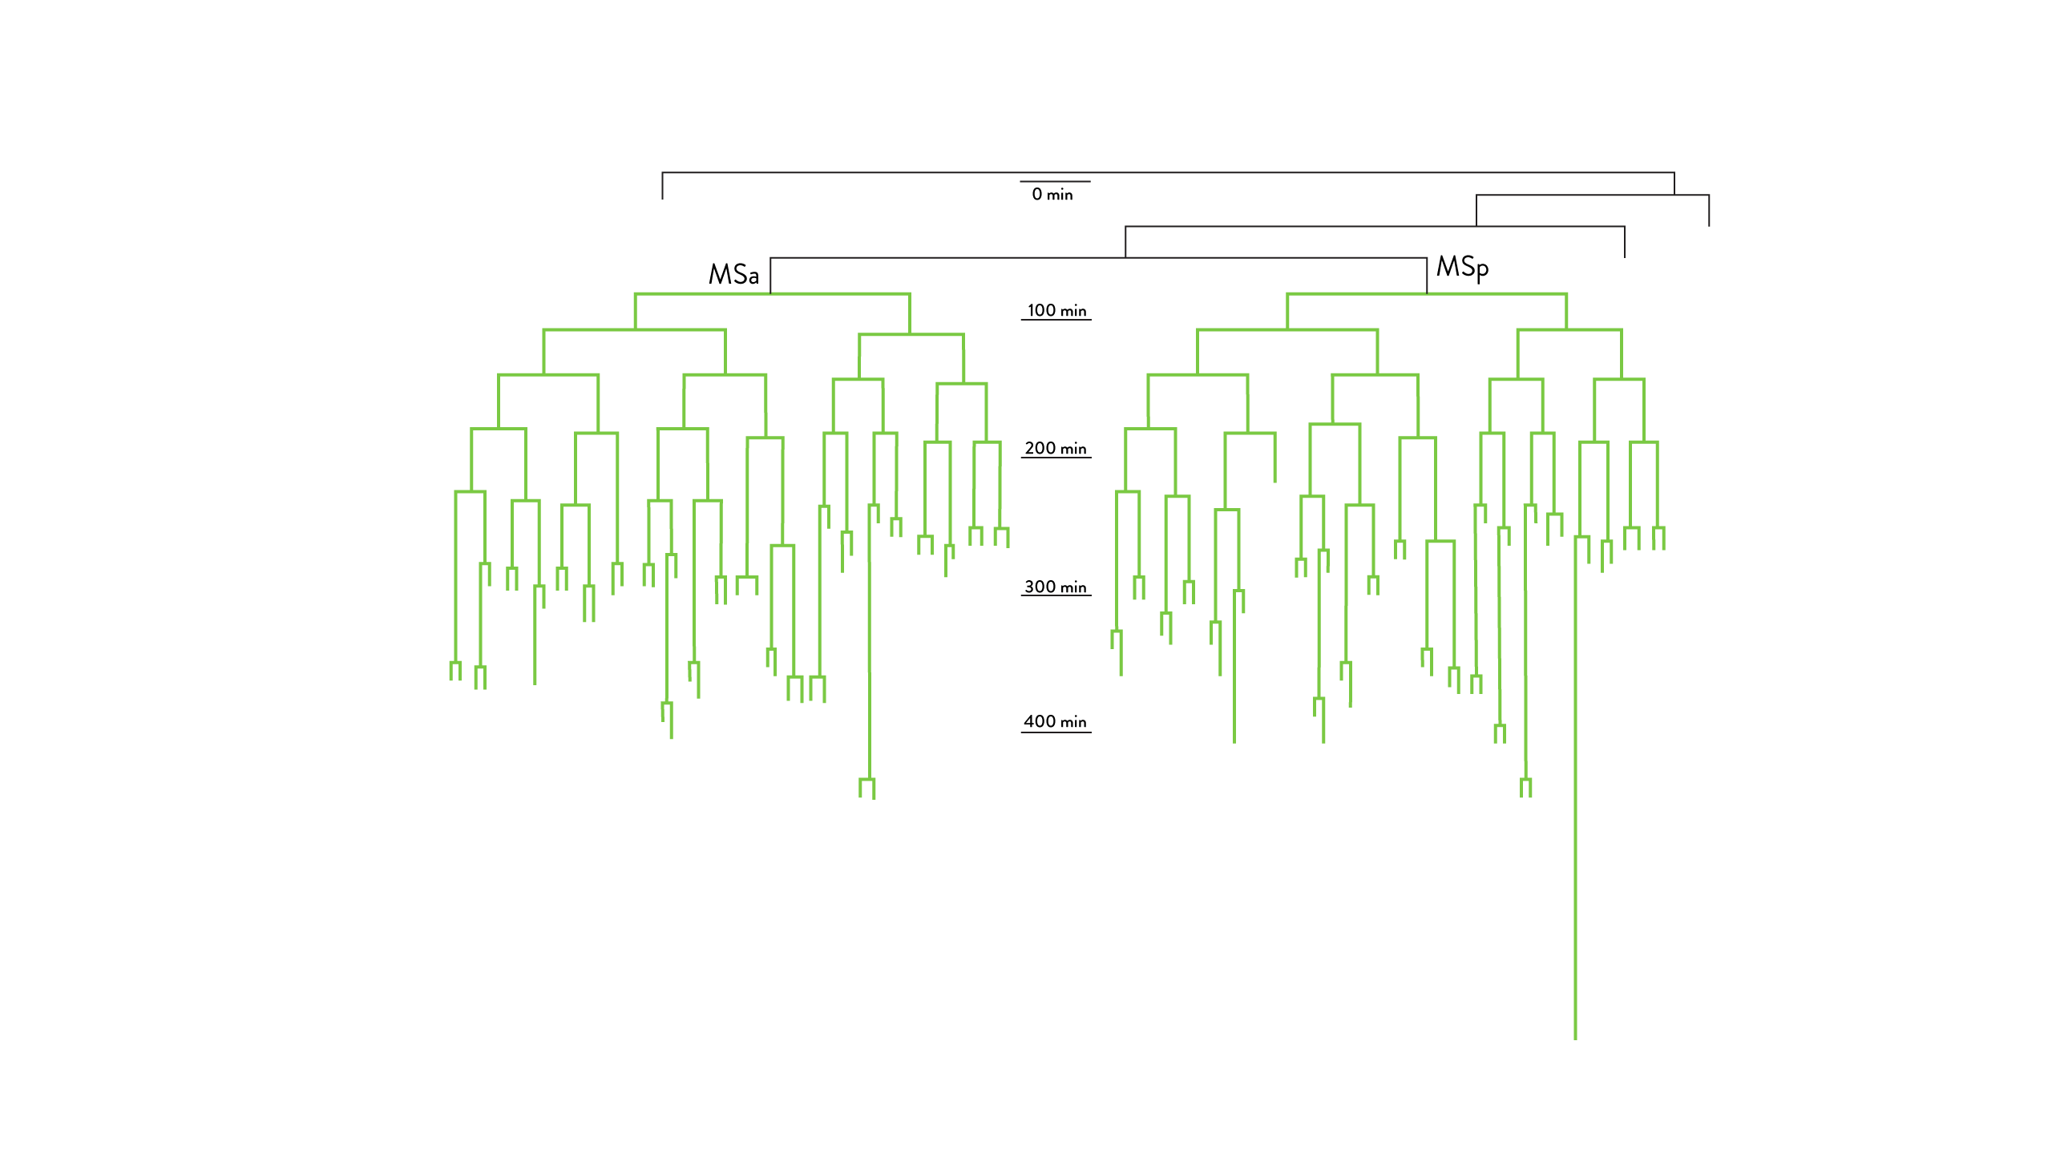

Slide 13
18%
19%
22%
39%

Slide 14
18%
19%
22%
39%

Slide 15
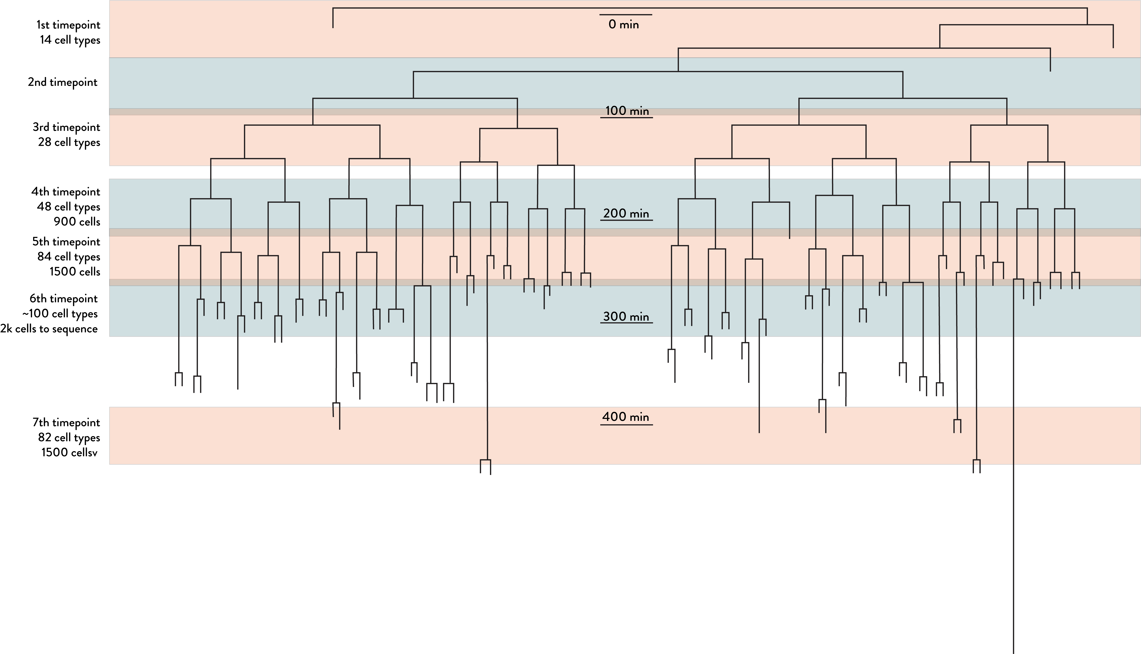

Slide 16
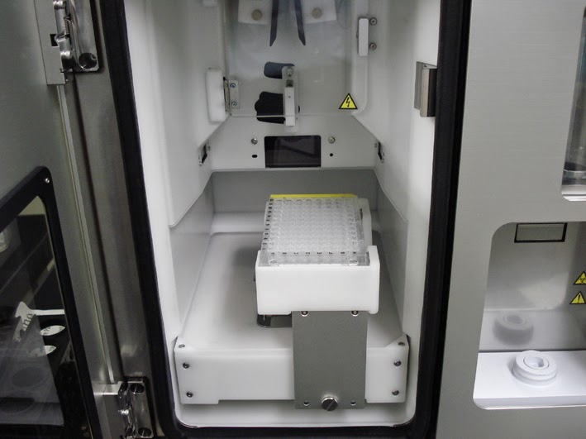
384 well holder

Slide 18
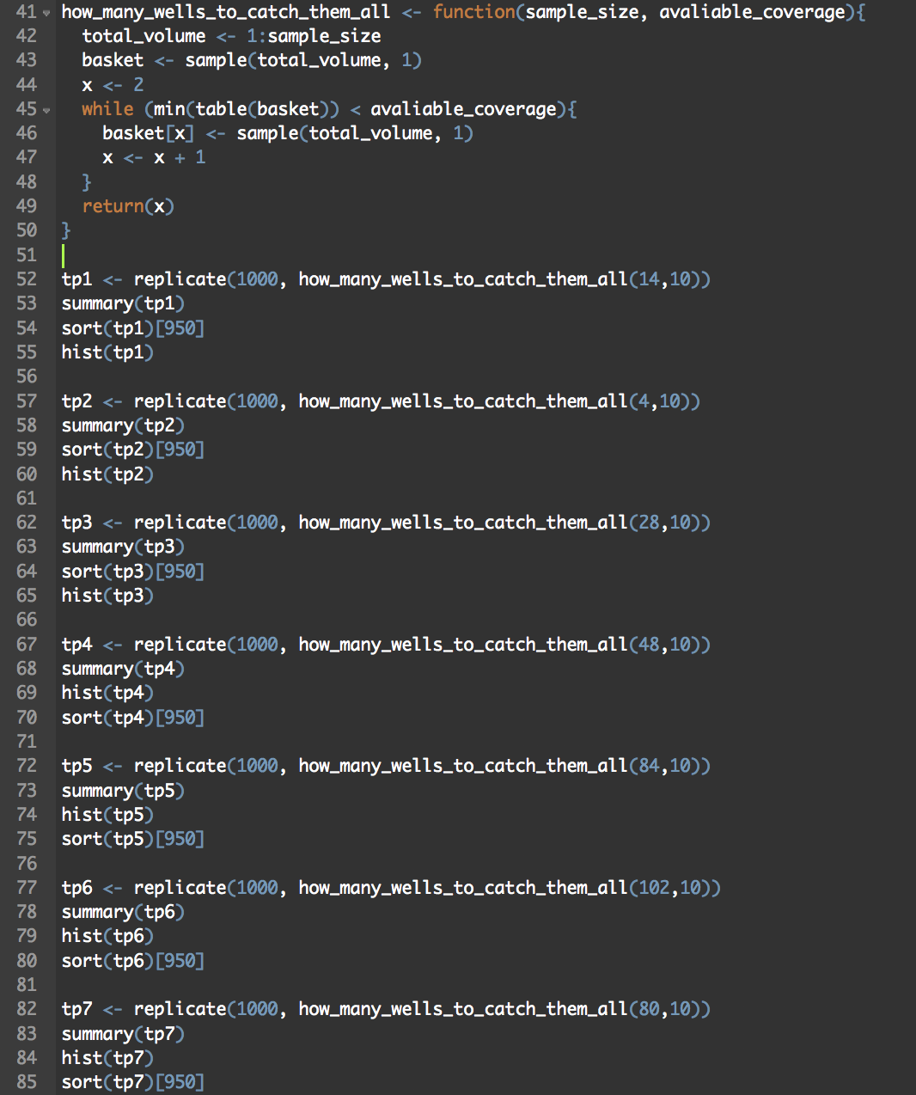
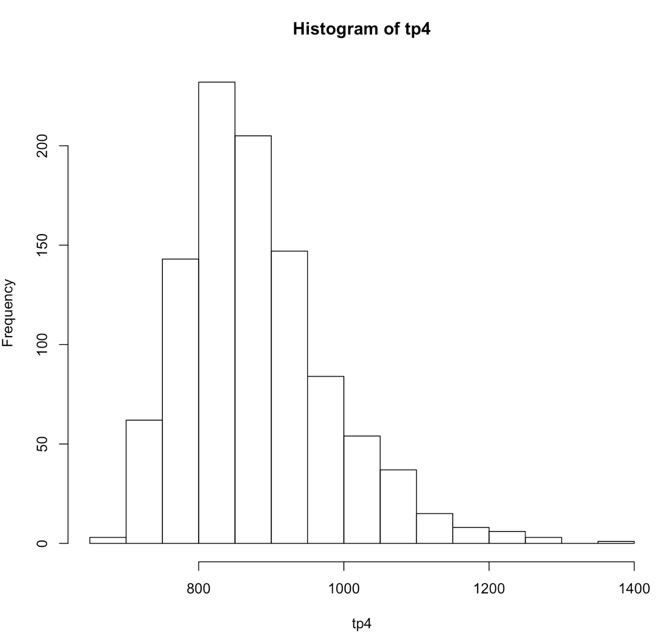

Slide 19
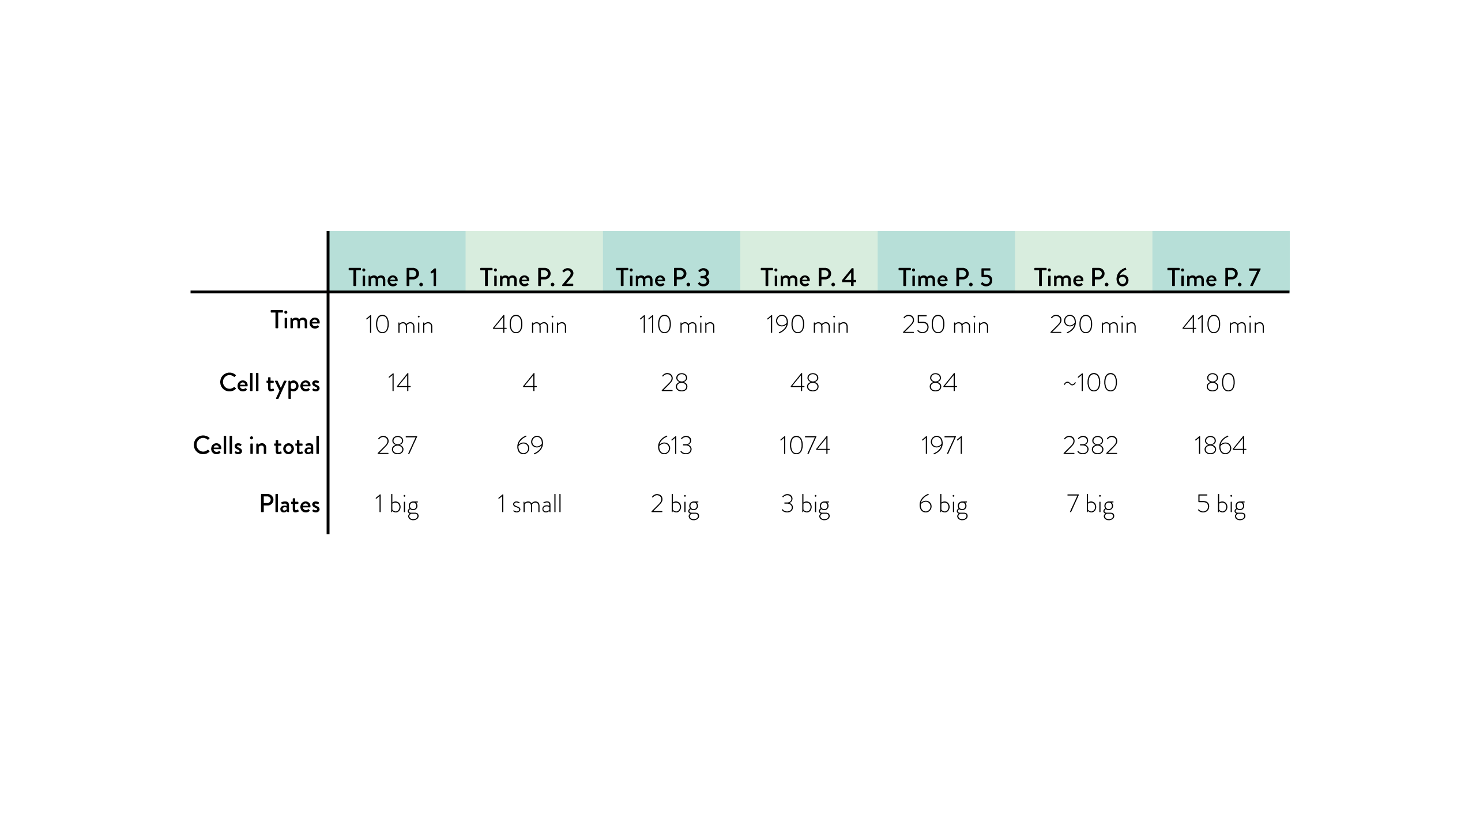

Slide 20

”I’m gonna do my own scRNA-seq! With template switching and NextSeq!”

Slide 21
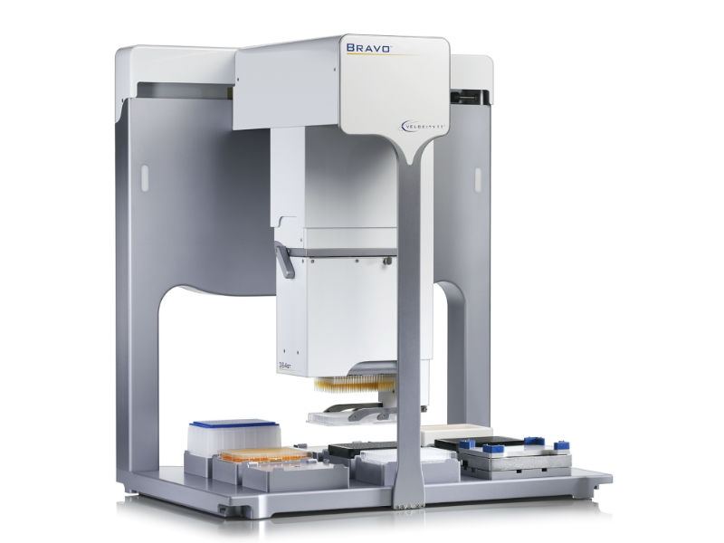
Agilent Bravo

Slide 24
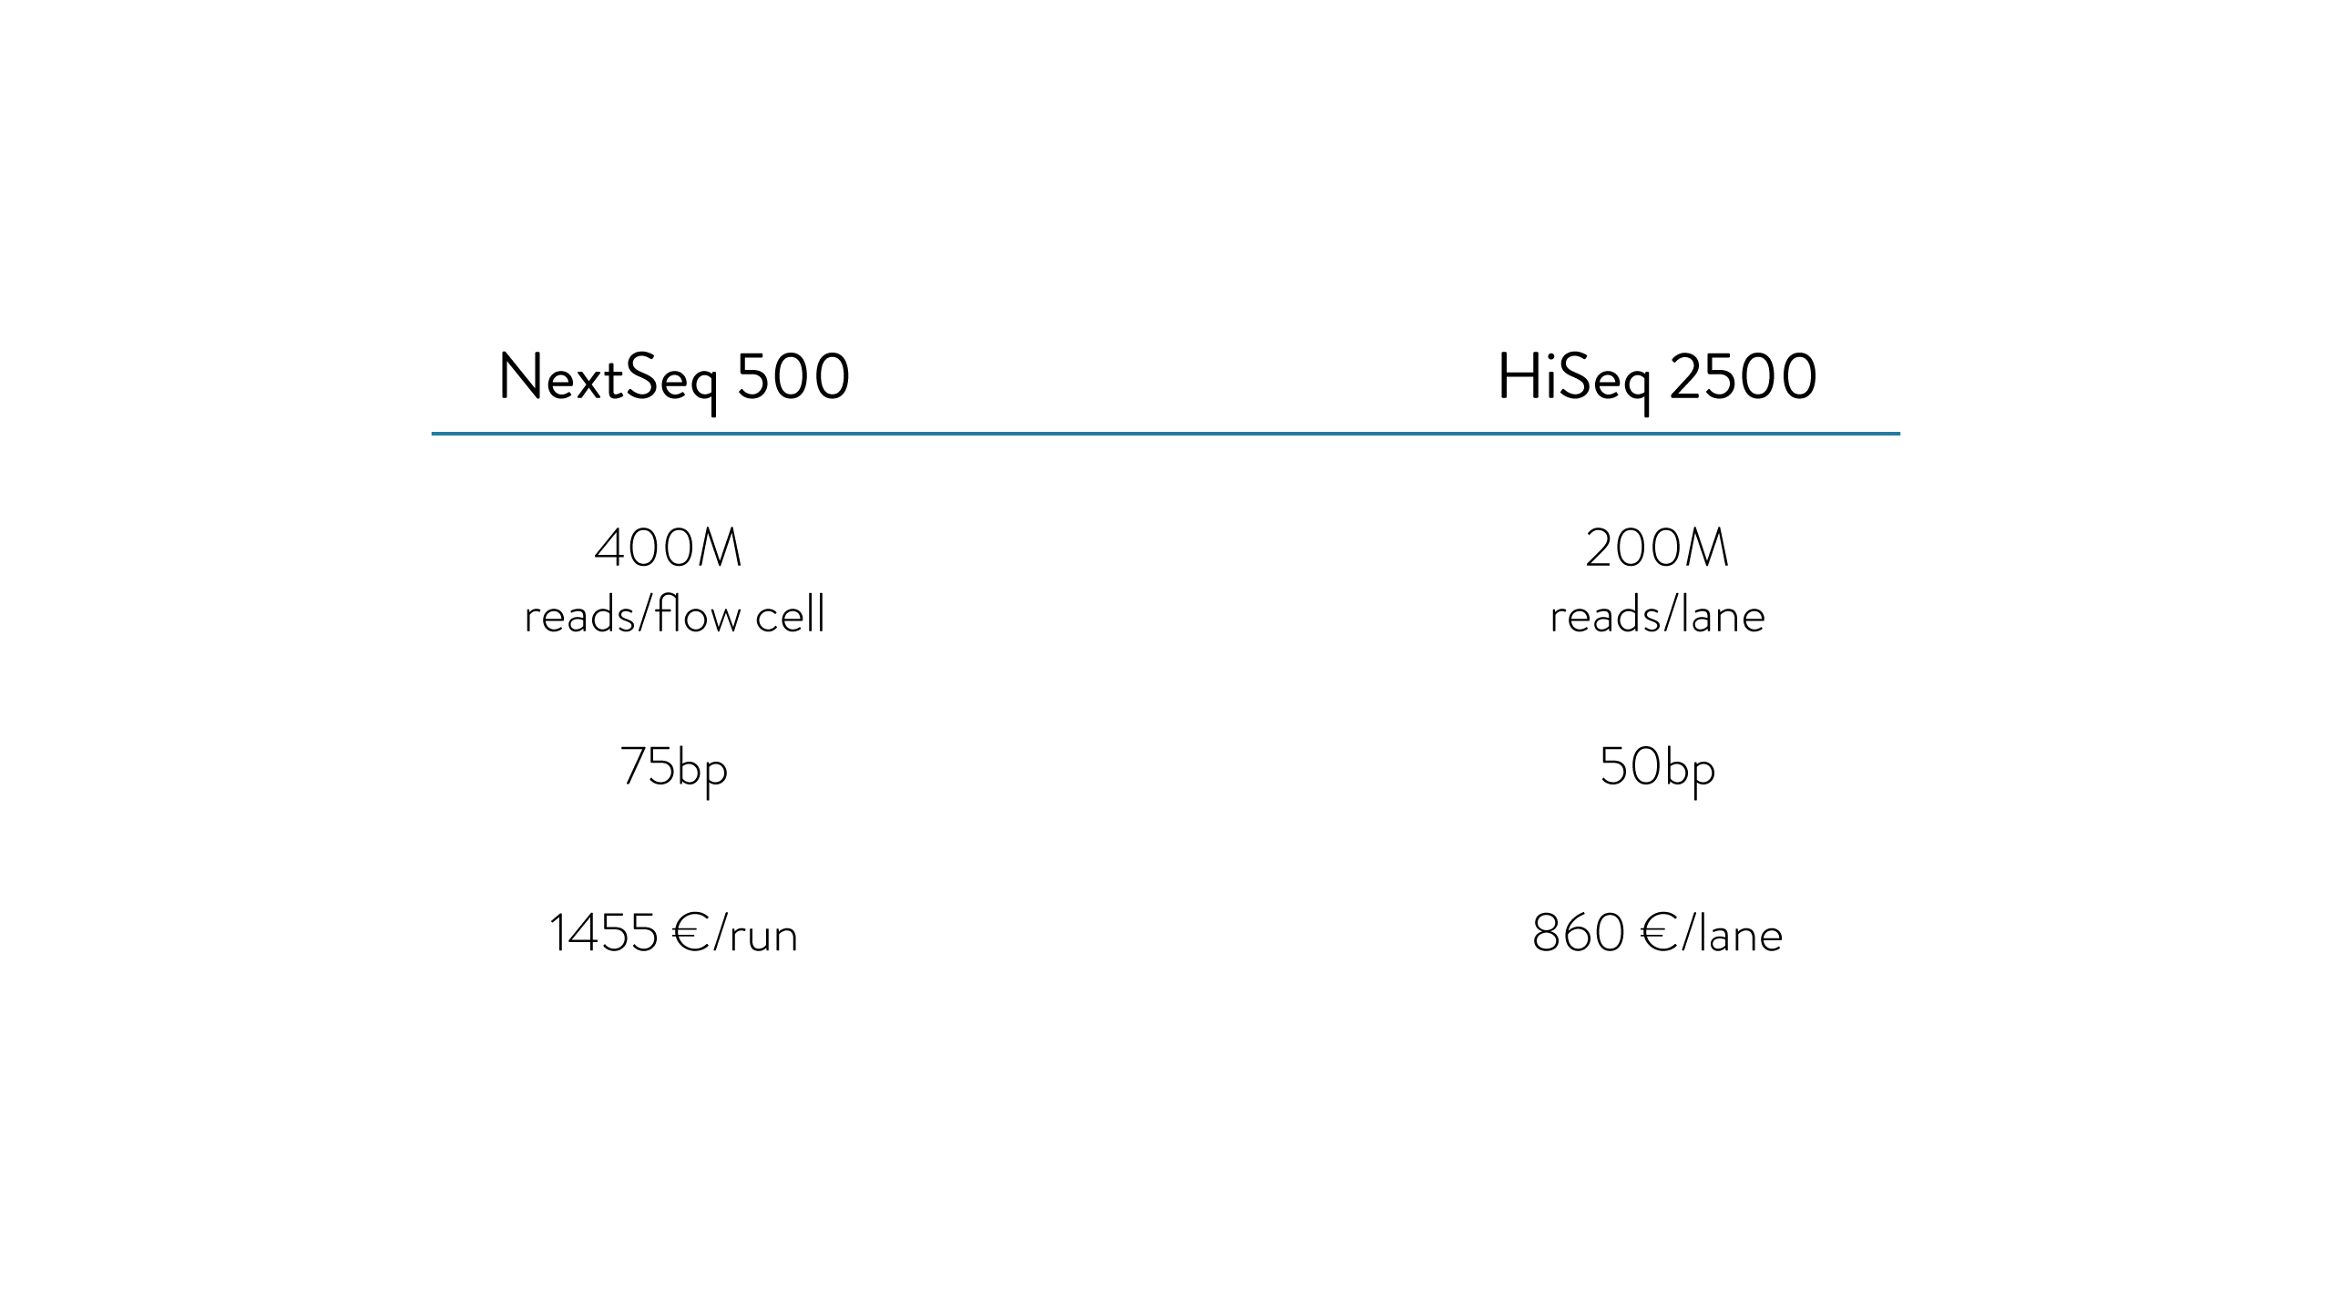

Slide 26
Thank you for your attention!

Slide 29
Notes:
We don’t know how exactly a cell acquires its final identity. Does a cell make a series of decisions, gradually restricting its developmental potential. Or in opposite all key changes happen only at the end, during the last divisions.
Of course we want to know what are the key developmental regulators that distinguish different lineage branches

Slide 30
Notes:
Also, we don’t know – do cells, with identical terminal fates pass through the same transcriptome changes during the development, or do they pass through different?

